Slide 1
IT TICKET ANALYSIS

Slide 2
PROBLEM STATEMENT
You are tasked with analyzing the IT support ticket management system to understand the performance of IT agents, the efficiency of ticket resolution, and the satisfaction levels of employees. The objective is to identify high and low performers among IT agents, assess the overall effectiveness of the team, and pinpoint areas for improvement in the ticket resolution process. The ultimate goal is to make informed staffing decisions, including hiring, firing, and training, to enhance overall service quality and team performance.

Slide 3
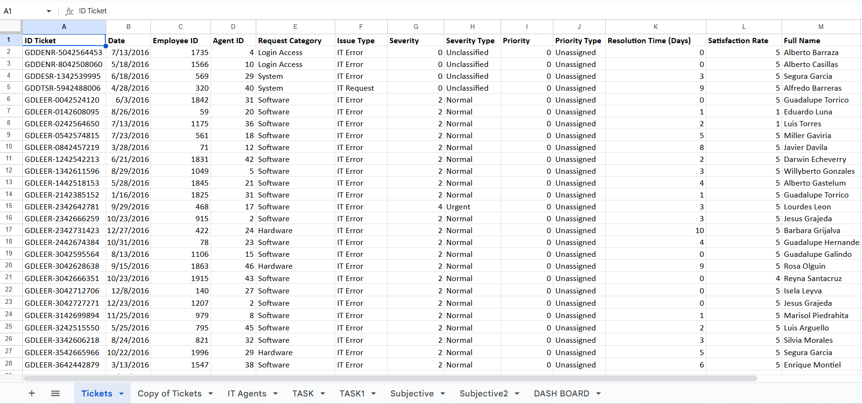
IT TICKETS DATA

Slide 4
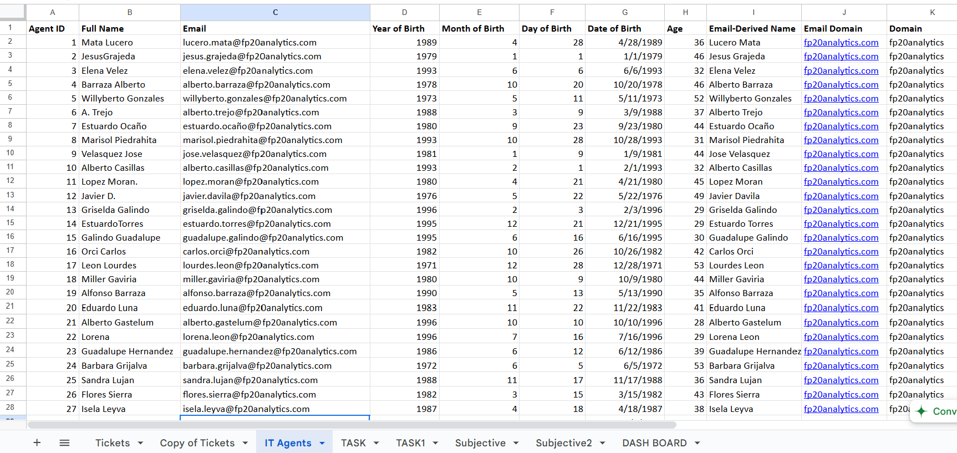
IT AGENTS DATA

Slide 5
DATA OF TICKETS
The provided data sheets contain two primary sets of attributes related to IT tickets and agents:
Ticket Data Sheet (first image):
Ticket ID: A unique number assigned to each support ticket.
Date: The date when the ticket was created.
Agent ID: Identifier for the IT agent handling the ticket.
Request Category: Classification of the request (e.g., Login Access, System, Software, Hardware).
Issue Type: Nature of the IT issue (e.g., IT Error, IT Request).
Severity & Priority Type: Indicators of the urgency and importance of the issue.
Resolution Time (Days): Time taken to resolve the ticket.
Satisfaction Rate: Feedback score given by the employee after resolution.
Age: Age of the employee raising the issue.
Full Name: Full name of the employee.

Slide 6
DATA OF IT AGENTS
IT Agent Data Sheet (second image):
Full Name: Name of the IT agent.
Email: Agent’s official email address.
Year/Month/Day of Birth (DOB): Date of birth details.
Age: Current age of the IT agent.
Domain: Company’s email domain.
Key factors for analysis: From the ticket sheet: Ticket ID, Request Category, Resolution Time, and Satisfaction Rate. From the IT agent sheet: Full Name, Email, and Age. These attributes are essential for evaluating ticket handling efficiency and agent performance.

Slide 7
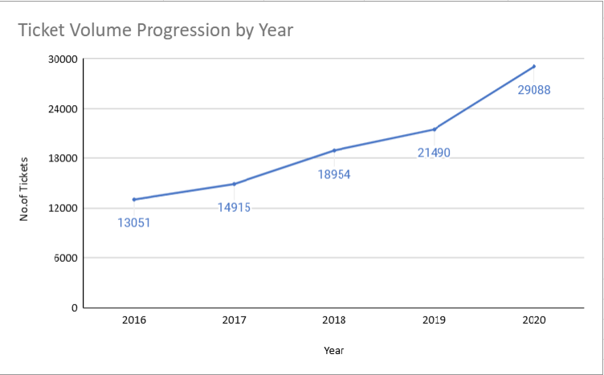
TICKET VOLUME BY YEAR
Ticket volumes have steadily increased from 2016 to 2020, more than doubling from 13,051 to 29,088, showing a clear rise in IT support demand. The sharp jumps in 2017–2018 and 2019–2020 highlight growing pressure on IT teams. To handle this rising demand, we need to review and strengthen our ticket management processes to improve efficiency and ensure better support for users.

Slide 8
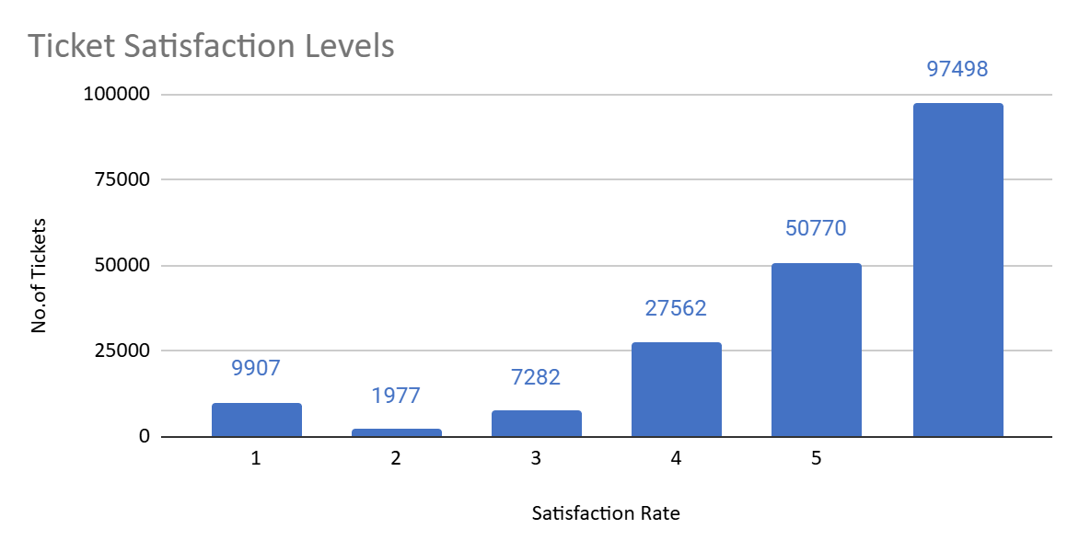
TICKET BY SATISFACTION RATE
Investing in advanced technology can help speed up ticket resolution and improve employee satisfaction. With proper implementation and training, we can further strengthen our already high satisfaction levels.

Slide 9
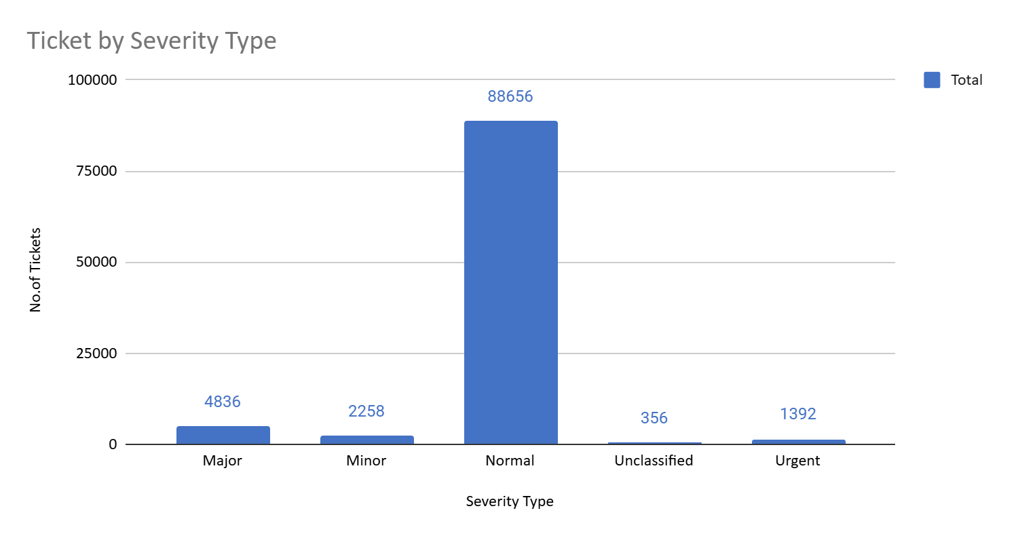
TICKET BY SEVERITY TYPE
Although most IT tickets are in the normal category, greater attention should be given to the major category, as these issues often affect crucial operations and demand prioritized handling and resources.

Slide 10
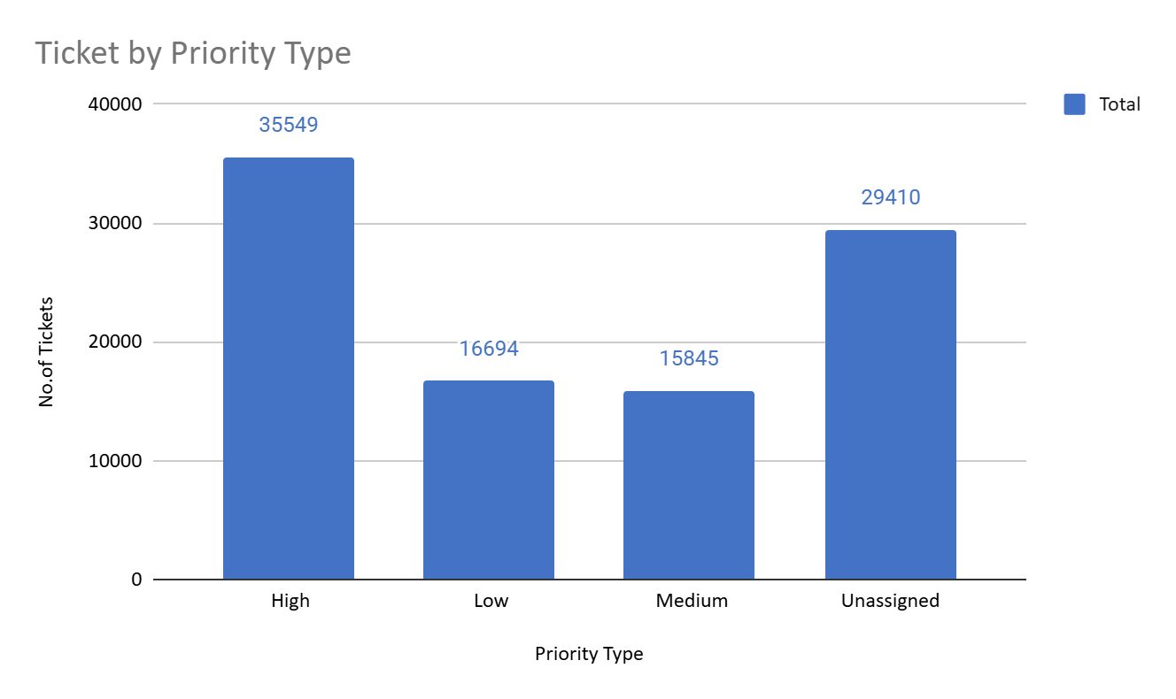
TICKET BY PRIORITY TYPE
A large portion of tickets are marked as high priority or remain unassigned, highlighting the need for improved prioritization and smarter resource allocation to resolve urgent issues and handle unassigned tickets more efficiently.

Slide 11
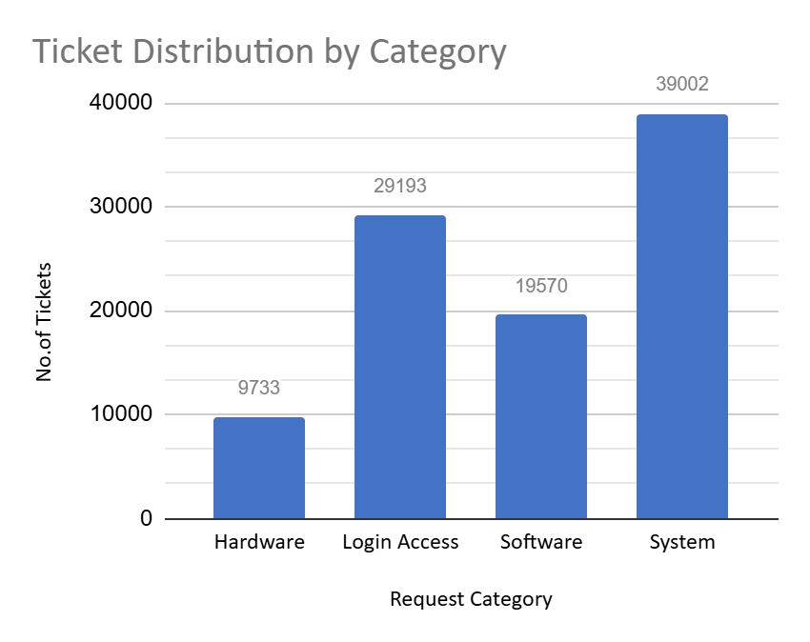
TICKET BY REQUEST CATEGORY
The majority of IT tickets involve login access and system issues, pointing to possible weaknesses in user onboarding and system stability. Strengthening authentication methods and improving system reliability will help minimize the occurrence of these recurring problems.

Slide 12
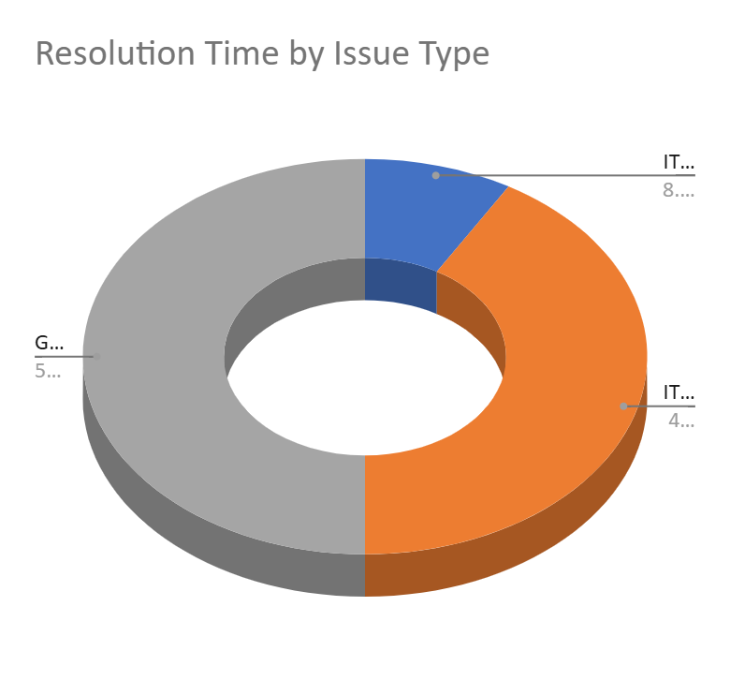
RESOLUTION TIME BY ISSUE TYPE
Ticket resolution is most common in the IT Request issue type, but these tickets also take longer to close. This suggests a need to optimize the handling process for this issue type. By adopting efficient workflows and automation tools, we can cut down resolution times and enhance overall productivity.

Slide 13
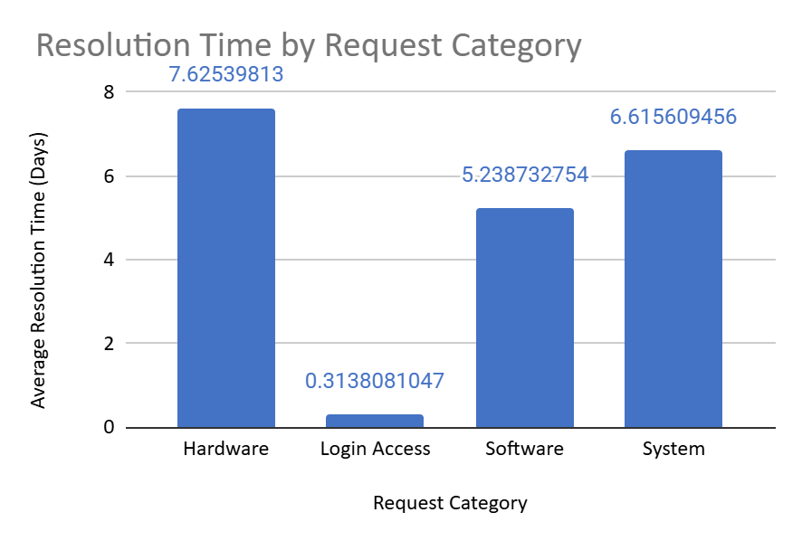
RESOLUTION TIME BY REQUEST CATEGORY
Resolution times for hardware and system requests remain significantly high, suggesting inefficiencies in managing these issues. To improve, we should refine processes for these categories, provide specialized staff training, and implement automation tools to speed up resolutions.

Slide 14
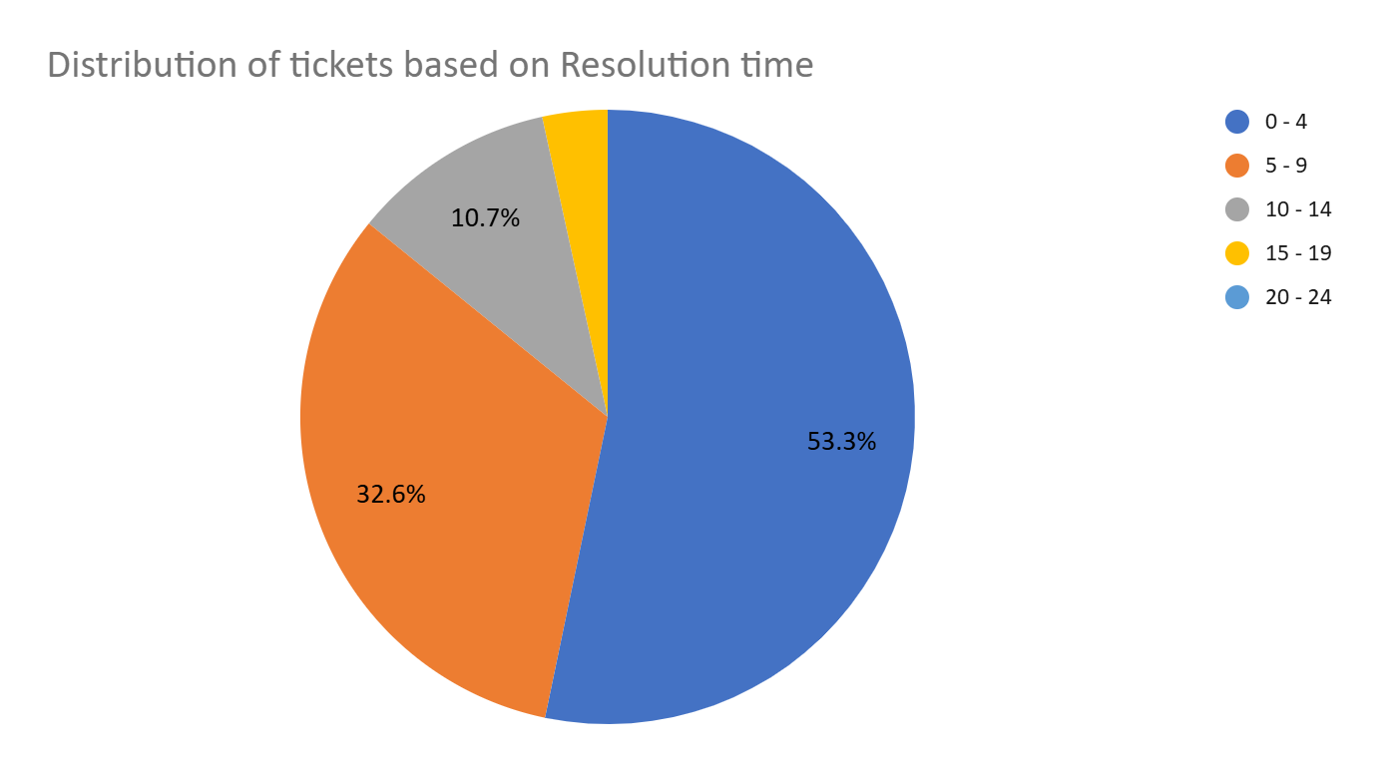
DISTRIBUTION OF EMPLOYEES BASED ON RESOLUTION TIME
DISTRIBUTION OF EMPLOYEES BASED ON RESOLUTION TIME AND SATISFACTION SCORE

Slide 15
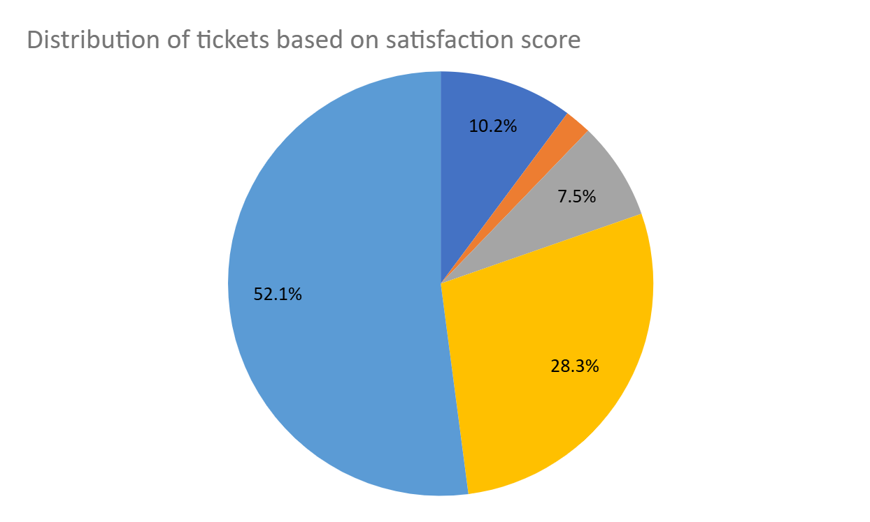
DISTRIBUTION OF EMPLOYEES BASED ON SATISFACTION SCORE
DISTRIBUTION OF EMPLOYEES BASED ON SATISFACTION SCORE

Slide 16
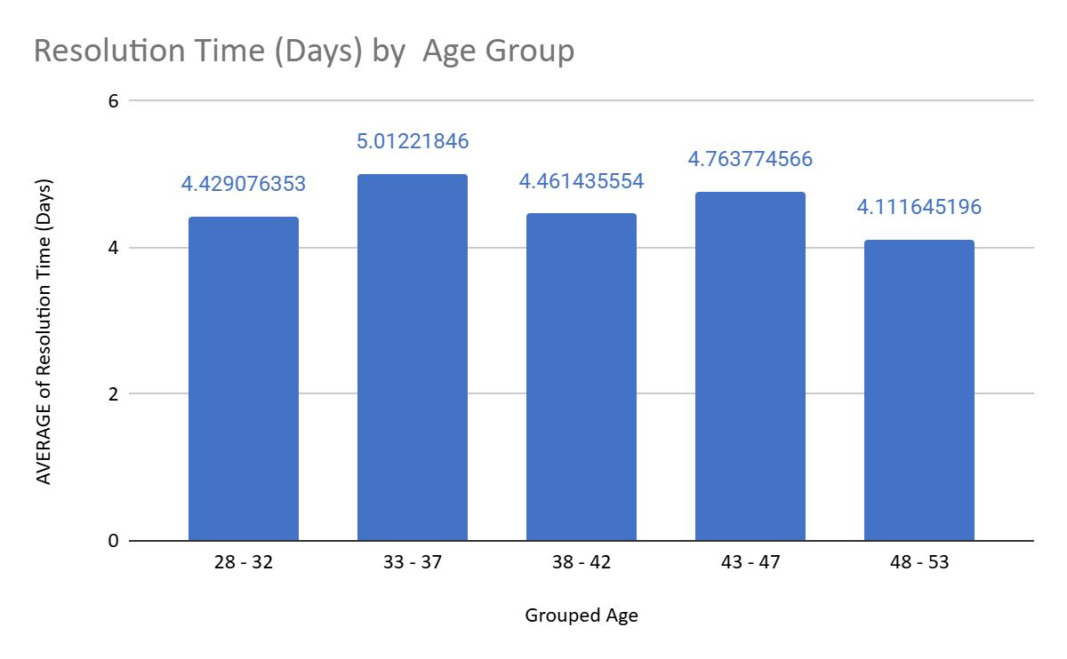
AVERAGE RESOLUTION TIME AND SATISFACTION RATE BY AGE GROUP
The 33–37 age group shows lower-than-expected average resolution times and satisfaction rates. To improve, targeted training, additional resources, and better support should be provided to enhance their performance and boost customer satisfaction.

Slide 17
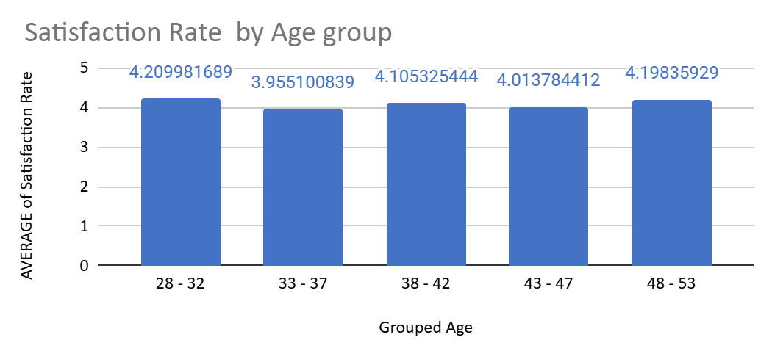
AVERAGE SATISFACTION RATE BY AGE GROUP
The 33–37 age group shows lower-than-expected average satisfaction rates. To improve, targeted training, additional resources, and better support should be provided to enhance their performance and boost customer satisfaction.

Slide 18
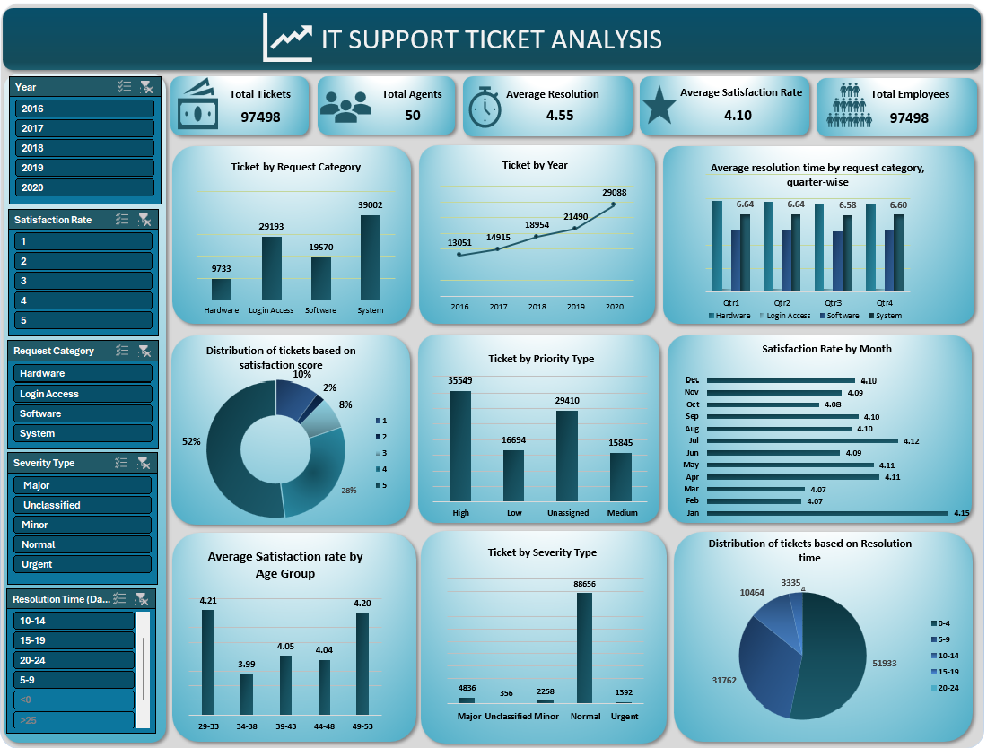
DASHBOARD

Slide 19
SUGGESTIONS
Rising Ticket Volumes: Ticket numbers are steadily increasing, placing greater pressure on IT agents. Strengthening the ticket management system is essential to boost efficiency and support.
Benefits of Technology Investment: Upgrading to advanced technology can significantly improve ticket resolution times and employee satisfaction. Proper implementation and training will maximize these gains.
Prioritizing Major Tickets: Although most tickets are normal, major tickets require focused attention and resources due to their critical impact on operations.
Managing High and Unassigned Tickets: A large share of tickets are either high priority or unassigned, indicating a need for better prioritization and smarter resource allocation to handle them effectively.
Addressing Common IT Issues: Many tickets involve login access and system-related problems, revealing gaps in user onboarding and system stability. Strengthening authentication measures and enhancing system reliability are key to reducing these recurring issues.

Slide 20
IT Request Resolution Time: IT Request tickets are resolved often but tend to take longer. Streamlining workflows and using automation tools can help cut resolution times and boost efficiency.
High Resolution Times: Hardware and system requests show notably high resolution times. Optimizing processes, offering specialized training, and leveraging automation can speed up these resolutions.
Age Group Performance Disparity: The 43–47 age group handles most tickets, while the 33–37 age group handles the least. Providing targeted training and support to the younger group can help balance workload distribution.
33–37 Age Group Challenges: The 33–37 age group records below-average resolution times and satisfaction rates. Focused training and additional resources can improve their performance and customer satisfaction.
Resource Allocation and Efficiency: Tackling high ticket volumes and lengthy resolution times calls for better prioritization, streamlined workflows, and smarter resource allocation to improve overall IT support effectiveness.
Tackling high ticket volumes and lengthy resolution times calls for better prioritization, streamlined workflows, and smarter resource allocation to improve overall IT support effectiveness.

Slide 21
CONCLUSION
To strengthen IT support, we should:
Increase Efficiency: Invest in advanced technology to optimize ticket management and shorten resolution times.
Address Critical Issues: Prioritize major ticket categories and enhance overall system stability.
Optimize Resources: Improve prioritization and manage high-priority and unassigned tickets more effectively.
Improve Training: Offer focused training and support for teams or age groups with lower performance.
Balance Workloads: Distribute tasks more evenly to boost team productivity and satisfaction.
Implementing these measures will enhance performance, efficiency, and satisfaction, ensuring we are well-prepared for future IT support needs.

